Slide 1
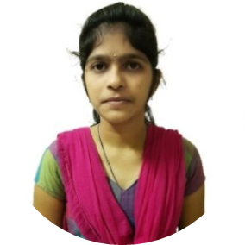
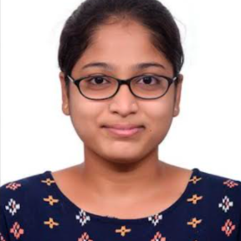
Jhansi Aneela Nerella Analyst @ Capgemini
Experience
I have good hands-on experience on Angular Developer.
I have extensively worked on Jira Tickets which has been assigned by clients.
Identifying, understanding and resolving issues related to Styling and Cosmetic Defects.
I have knowledge on HTML ,CSS, JavaScript, Angular, Java.
I got Certified on AWS Cloud Practioner.
Background
1 year of professional experience in the IT industry (current)
B. Tech in Electronics & communication Engineering (2017-2021) in KKR & KSR Institute of Technology & Sciences, Guntur (district), Andhra Pradesh.
Consulting Competencies
Leadership and Problem Solving
Adaptive to fast paced environment
Time management
Task driven.
Communicating clearly and empathetically
Credibility

